Slide 2
Digital Forensics Lecture-11
By- Dr.subhranil Das
Assistant Professor
School of computer Science

Slide 3

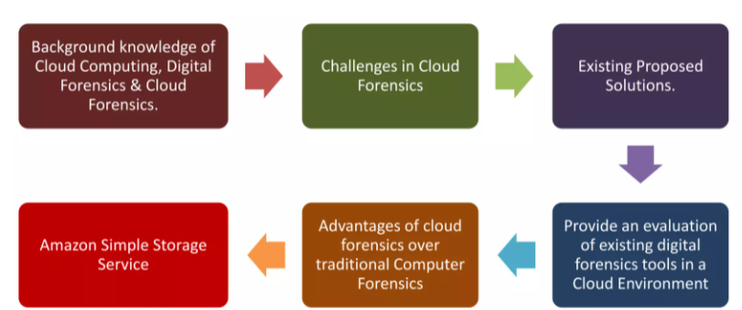
Contents of Cloud Forensics

Slide 4
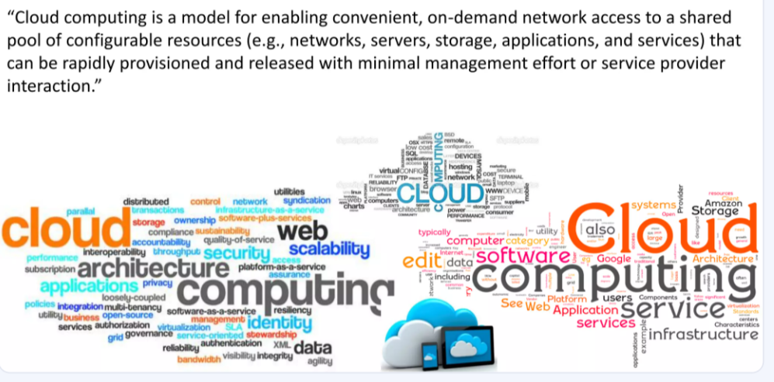
Definition of Cloud Computing

Slide 5
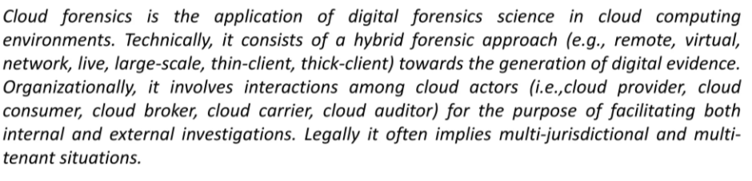
Definition of Cloud Forensics

Slide 6
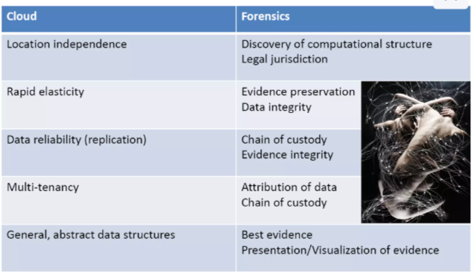
Differentiate between cloud and forensics

Slide 7
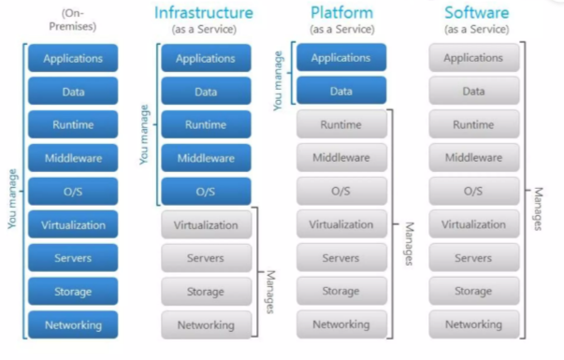
Cloud Structure

Slide 8
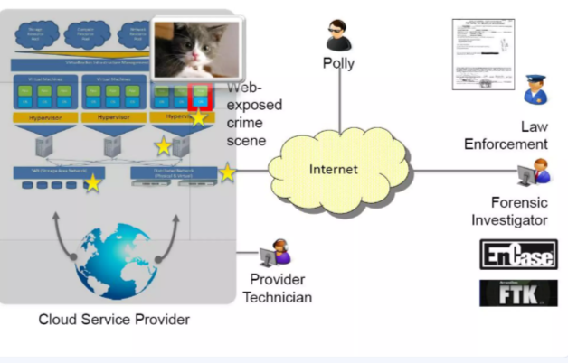
Cloud Crime Scene

Slide 9
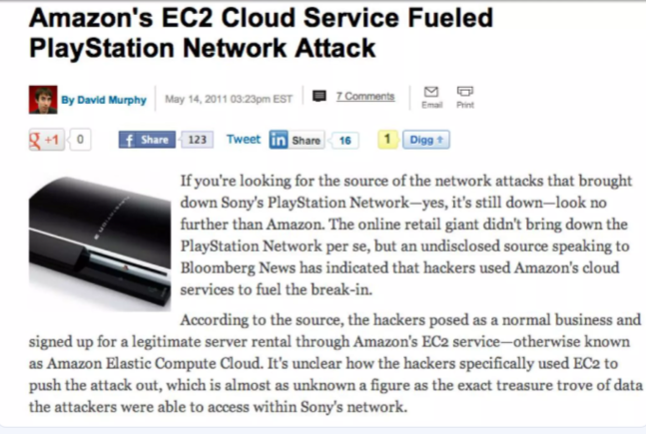
First Cloud Crime

Slide 10
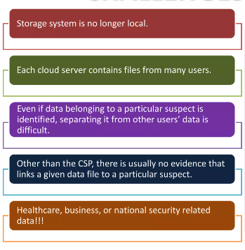
Challenges in Cloud Forensics

Slide 11
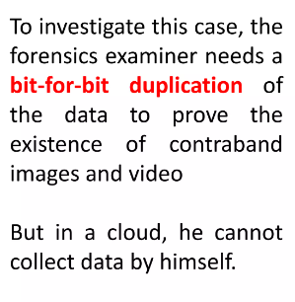
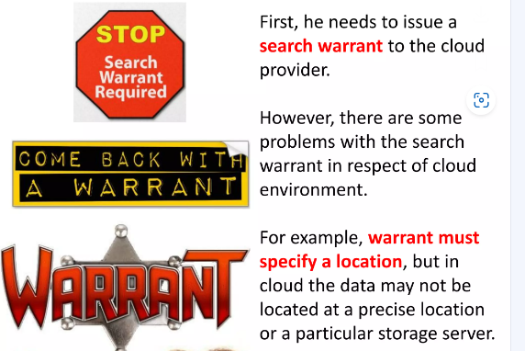
Case study in child Pornography

Slide 12
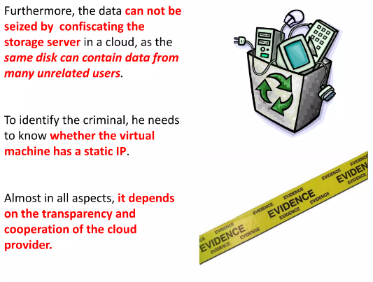
Case study in child Pornography

Slide 13
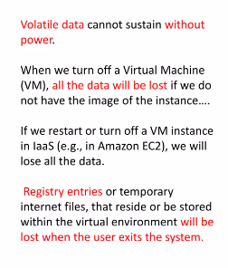
Volatile Data

Slide 14
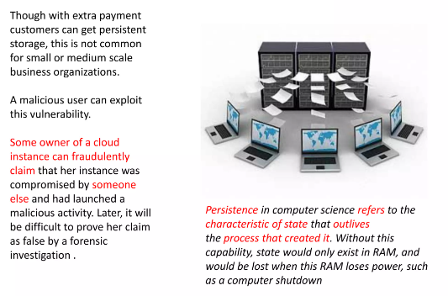
Volatile Data

Slide 15
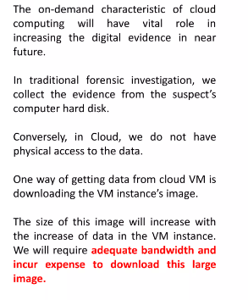
Large BW Requirement

Slide 16
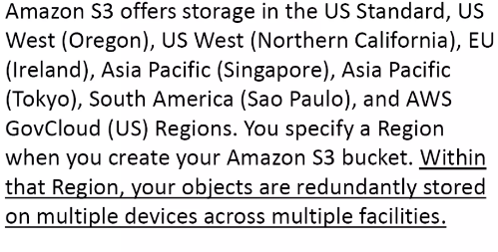
Where is my data stored?

Slide 17
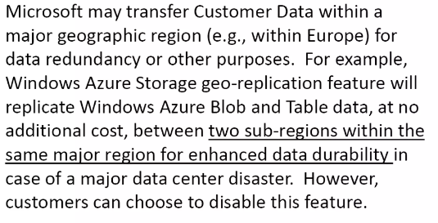
Location of customer data

Slide 18
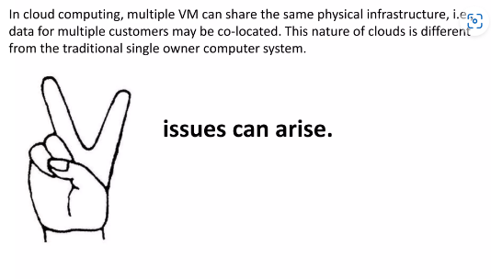
Multi-Tenancy

Slide 19
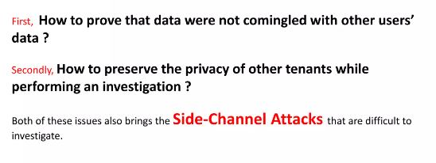
Issue of multi-tenancy

Slide 20
Next Lecture
Cloud Forensics

